Slide 1
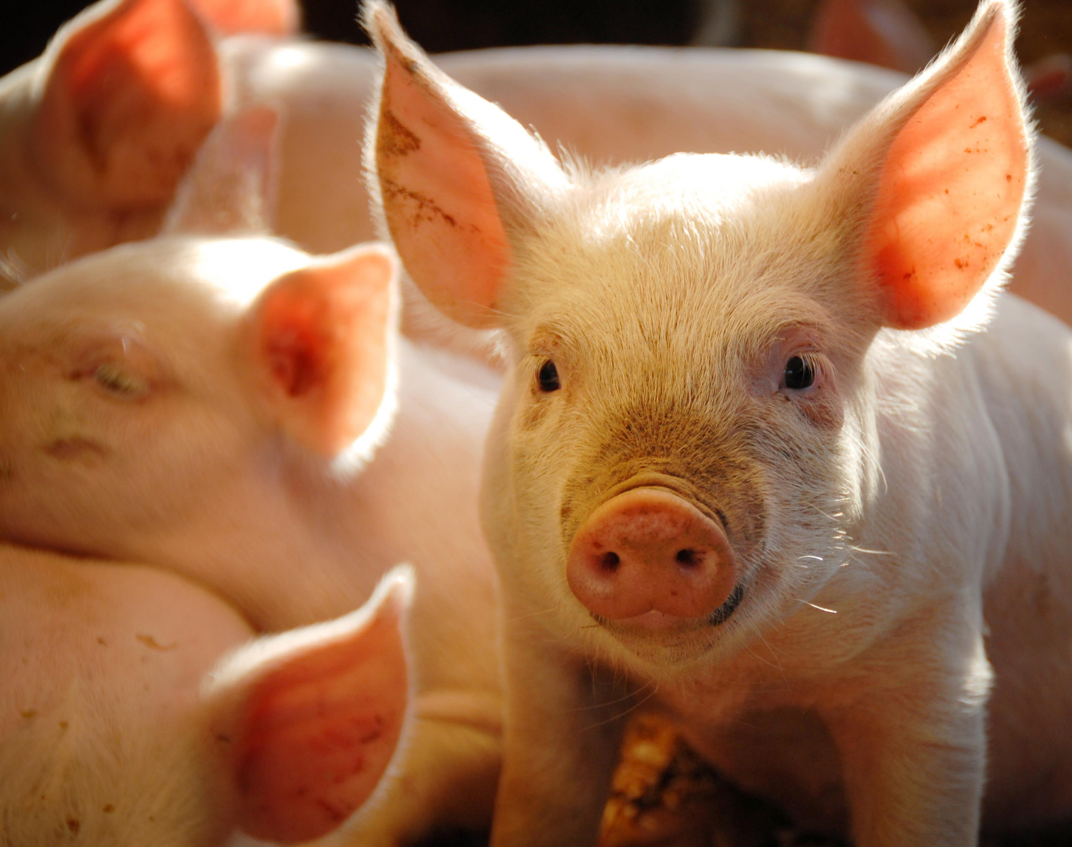
Hogwash or Sow Right?

Slide 2
Pigs prefer to be clean
TRUE
FALSE

Slide 3
TRUE! Pigs are usually seen in mud because they do not have sweat glands. The mud keeps them cool and also acts much like a sunscreen does for you and I.

Slide 4
Pigs have a good sense of smell and eyesight
TRUE
FALSE

Slide 5
FALSE!
Pigs have a great sense of smell but their eyesight is poor
Fun Fact: Pigs have 15,000 taste buds, while humans only have 9,000.

Slide 6
Pigs are slow growing animals?
TRUE
FALSE

Slide 7
FALSE! Pigs are the fastest growing livestock Fun Fact: Piglets are about 2.5 lbs. when born and in 6 months they reach 280 lbs.

Slide 8
Pigs are smarter than dogs?
TRUE
FALSE

Slide 9
TRUE
Pigs rank as the seventh smartest animal on the planet.
Orangutans, octopus, parrots, elephants, chimpanzees and dolphins are the only animals smarter than pigs.
Fun Fact: You can train pigs to play video games or even paint you a picture!

Slide 10
Pork is not eaten by many throughout the world?
TRUE
FALSE

Slide 11
FALSE
Pork is the most consumed meat in the world mostly because of all the different ways it can be used, and it is easy to preserve.

Slide 12
Pigs walk on all their toes
TRUE
FALSE

Slide 13
FALSE
Pigs have 4 toes on each foot, but only walk on 2 of them.
The two central toes make direct contact with the ground, providing stability and support as they move. The other two toes are smaller and located higher up on the leg making it harder for them to be used as weight bearing toes.

Slide 14
Pigs can fly?
TRUE
FALSE

Slide 15
FALSE Although pigs can NOT fly, they are very fast! Fun Fact: Pigs can run a 7-minute mile.

Slide 16
Piglets are baby pigs?
TRUE
FALSE

Slide 17
TRUE
Fun Fact: A sow (mom pig) averages 8-10 piglets per litter and can farrow twice a year.
Litter: a group of piglets
Farrow: to give birth

Slide 18
Pigs need lots of attention?
TRUE
FALSE

Slide 19
TRUE
Pigs are very social animals.
They like to sleep touching each other and in many cases touching nose to nose or in a “pig pile.”
Pigs do not like to be by themselves. This is why you tend to see them in bigger groups.
Fun Fact: Sows will always sing to their piglets when the piglets are nursing.

Slide 20
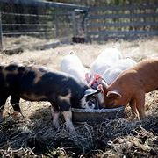
The phrase to “pig out” came about because pigs will overeat?
TRUE
FALSE

Slide 21
FALSE
Pigs are fed carefully balanced rations matched to their age and weight that consists of feeds such as corn, barley & soybeans.
Ration: amount of feed consumed by one animal for one day.
Fun Fact: Pigs gain one pound of weight after eating 2.5 – 3 pounds of feed and an adult pig can consume 14 gallons of water a day!

